Slide 1

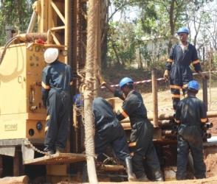
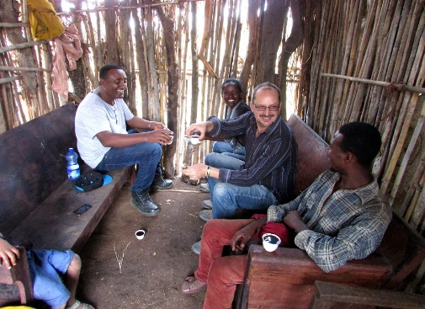
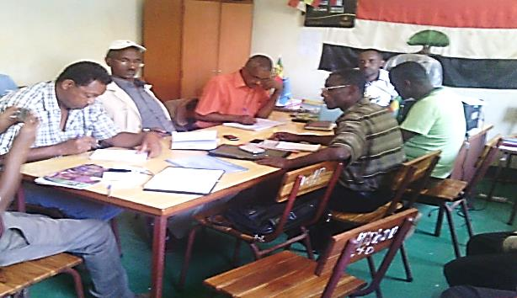
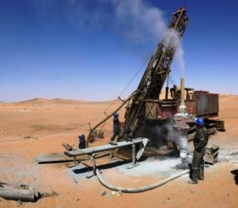
Developing a +100,000 oz. p.a Gold Producer
Then Expanding in the Arabian-Nubian Shield
UK Investor Show
30 April 2016

Slide 2
DISCLAIMER
The information contained in this document (“Presentation”) has been prepared by KEFI Minerals plc (the “Company”). While the information contained herein has been prepared in good faith, neither the Company nor any of its shareholders, directors, officers, agents, employees or advisers give, have given or have authority to give, any representations or warranties (express or implied) as to, or in relation to, the accuracy, reliability or completeness of the information in this Presentation, or any revision thereof, or of any other written or oral information made or to be made available to any interested party or its advisers (all such information being referred to as “Information”) and liability therefore is expressly disclaimed. Accordingly, neither the Company nor any of its shareholders, directors, officers, agents, employees or advisers take any responsibility for, or will accept any liability whether direct or indirect, express or implied, contractual, tortious, statutory or otherwise, in respect of, the accuracy or completeness of the Information or for any of the opinions contained herein or for any errors, omissions or misstatements or for any loss, howsoever arising, from the use of this Presentation.
This Presentation may contain forward-looking statements that involve substantial risks and uncertainties, and actual results and developments may differ materially from those expressed or implied by these statements. These forward-looking statements are statements regarding the Company's intentions, beliefs or current expectations concerning, among other things, the Company's results of operations, financial condition, prospects, growth, strategies and the industry in which the Company operates. By their nature, forward-looking statements involve risks and uncertainties because they relate to events and depend on circumstances that may or may not occur in the future. These forward-looking statements speak only as of the date of this Presentation and the Company does not undertake any obligation to publicly release any revisions to these forward-looking statements to reflect events or circumstances after the date of this Presentation.
This Presentation should not be considered as the giving of investment advice by the Company or any of its shareholders, directors, officers, agents, employees or advisers. Each party to whom this Presentation is made available must make its own independent assessment of the Company after making such investigations and taking such advice as may be deemed necessary.
Neither this Presentation nor any copy of it may be (a) taken or transmitted into Australia, Canada, Japan, the Republic of Ireland, the Republic of South Africa or the United States of America (each a “Restricted Territory”), their territories or possessions; (b) distributed to any U.S. person (as defined in Regulation S under the United States Securities Act of 1933 (as amended)) or (c) distributed to any individual outside a Restricted Territory who is a resident thereof in any such case for the purpose of offer for sale or solicitation or invitation to buy or subscribe any securities or in the context where its distribution may be construed as such offer, solicitation or invitation, in any such case except in compliance with any applicable exemption. The distribution of this document in or to persons subject to other jurisdictions may be restricted by law and persons into whose possession this document comes should inform themselves about, and observe, any such restrictions. Any failure to comply with these restrictions may constitute a violation of the laws of the relevant jurisdiction.

Slide 3
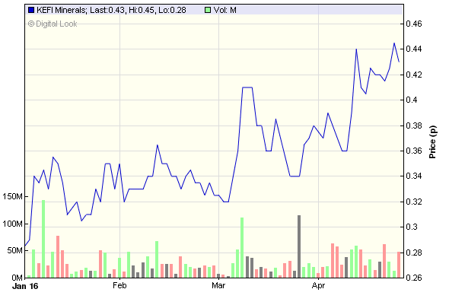
Corporate Overview
 | At 25 April 2016
AIM code | KEFI
Share price - 12 mth | 0.26p (low)/1.07p (high)
Share price – current | 0.45p
Shares in issue | 3.12 billion
Market cap | £14M (US$22M)
Nomad | SP Angel
Brokers | Brandon Hill Capital Beaufort Securities
Source: Digitallook – 2016 YTD chart
Key Shareholders (fully-diluted)
Odey Asset Management | 25%
Ausdrill | 6%
Board of Directors | 10%
Board of Directors
Harry Anagnostaras-Adams | Executive Chairman
Jeff Rayner | Exploration Director
Ian Plimer | Non-Executive
John Leach | Non-Executive
Norman Ling | Non-Executive

Slide 4
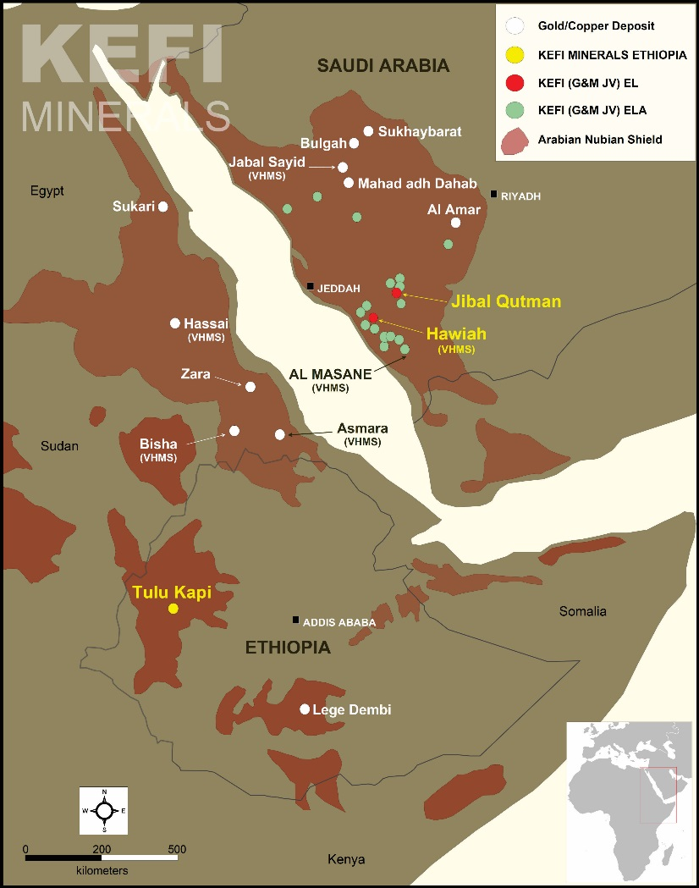
Emerging Gold Miner
in Arabian-Nubian Shield
  KEFI in Ethiopia
  KEFI in Saudi Arabia
    Project on track to start open pit production of
    c. 115,000 oz p.a. gold by Q4 17
    Exploring large pipeline of Exploration Licences since 2007 in joint venture with respected Saudi partner
  Location of KEFI’s c.1,500 km² exploration portfolio in the ANS

Slide 5
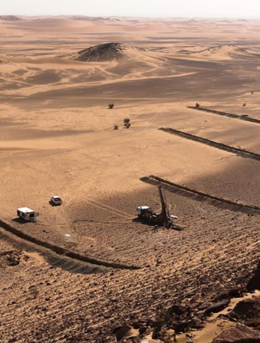
Saudi Arabia (KEFI 40%)
Large Exploration Portfolio
  Jibal Qutman
  0.7 Moz gold resource defined at Jibal Qutman
  Evaluating low-cost, heap-leach treatment of oxide ore
  Low capex & quick start-up
  Mining Licence Application being discussed with regulators
  Targeting Jibal Qutman cash flows to fund exploration in Saudi Arabia
  Hawiah
  Potential for very large Cu-Au-Zn orebody
  Gossan horizon extends 6 km
  Trenching indicates gold enriched near surface
  Geophysics indicates large metal-bearing body below gossan
  Establishing stakeholder relationships prior to drilling
  Drilling at Jibal Qutman

Slide 6
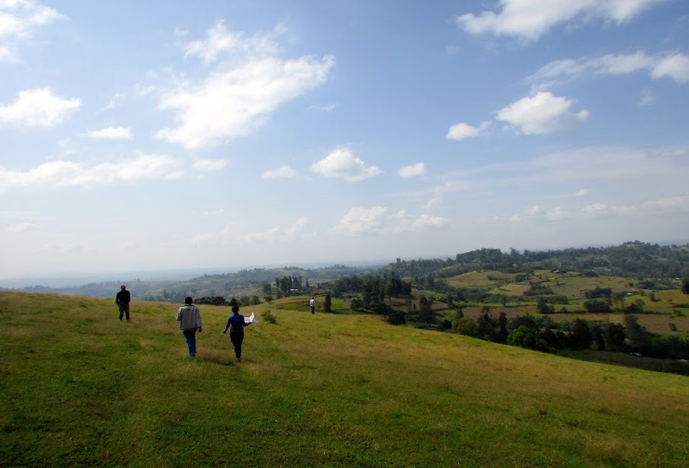
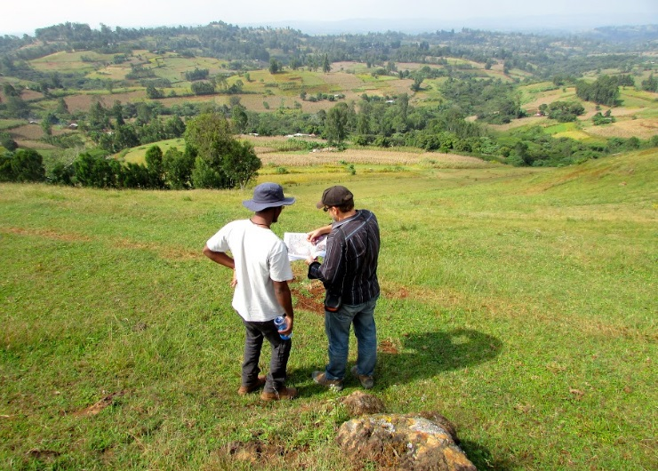
Ethiopia
Building the Tulu Kapi Gold Mine
  Ethiopia:
    Thriving economy
    Government actively boosting mining sector
    Prospective country with limited modern exploration
    Rapidly improving infrastructure and cheap electricity
  Attractive fiscal environment:
    20-year Mining Licence
    5% Government free-carried equity in project
    7% royalty
    25% income tax with accelerated depreciation of capex and sunk costs
    First major mine development in stable and high growth country
    Strong support and investment from
    Ethiopian Government
  Tulu Kapi project site

Slide 7
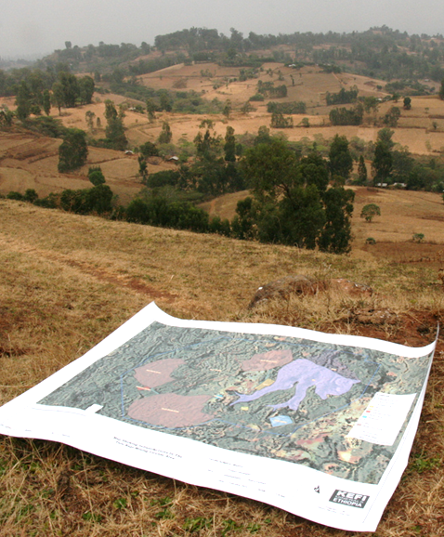
Tulu Kapi
History
  2013:
  Previous owners had spent >$50 million on drilling and studies
  Development plan required capex of US$289 million
  KEFI acquired 75% for $10/ounce of Ore Reserves
  2014:
  KEFI transformed project economics by reducing development capex and unit costs, thus reducing risk and increasing returns
  Better orebody definition increased Ore Reserve grade
  KEFI acquired the remaining 25% of Tulu Kapi
  2015:
  Mining Agreement signed with Government
  Completed revised Tulu Kapi DFS – required funding halved
  Selected preferred contractors, financiers and maintained alternatives for each role within finance syndicate
  Looking towards site of Tulu Kapi tailings storage facility

Slide 8
Improved Project Metrics Flowing from KEFI’s Work
with Technical Experts and Project Contractors
 | Previous Owner | 2015 DFS | Current Plan
Projected capex and working capex | US$289M | US$130M | US$120M
Projected funding requirement after adding finance costs & cost-overrun facility | N.A | N.A | US$145M
Net project cash surplus before tax | US$235M | US$338M | US$374M
Life of Mine gold production | 924Koz | 961Koz | 980Koz
Annual gold production | 105Koz | 89Koz | 115Koz
Strip ratio | 8.5 | 7.5 | 7.5
Average gold grade | 1.8g/t | 2.1g/t | 2.1g/t
Annual processing rate | 2.0Mtpa | 1.2Mtpa | 1.5Mtpa
All-in Sustaining Cost (AISC) | N.A. | US$779/oz | US$745/oz
All-in Cost (includes initial capex) | US$1,044/oz | US$906/oz | US$842/oz
  Gold price assumed at US$1,250/oz. Current Plan completes mining of open pit in 8 years, versus 10 years in 2015 DFS.
  KEFI expanded Indicated Resource from 1.1Moz to 1.6Moz but kept Ore Reserve at 1Moz (2.1g/t ore compared with previous 1.8g/t ore).
  KEFI wire-framed all lodes and introduced semi-selective mining to minimise waste, optimise ore grade and scale-down capex.
  “Projected Funding Requirements” include Jan 16 estimated capital expenditure, working capital, cost overrun facilities and transaction costs.

Slide 9
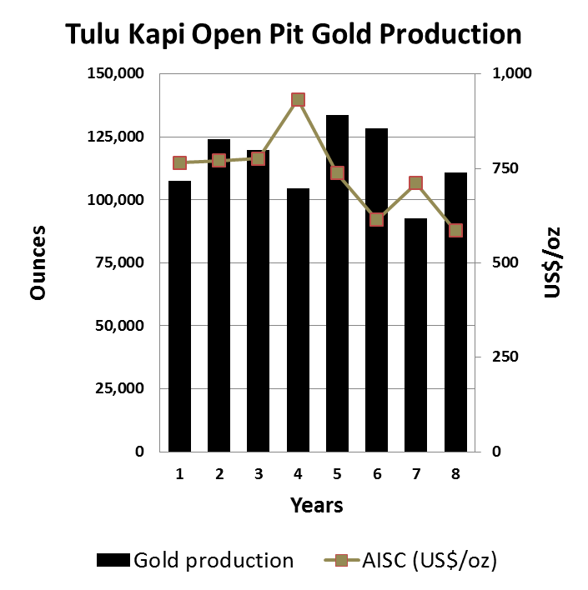
Tulu Kapi
Open Pit Metrics
Project Physicals
Waste/ore ratio | 7.5:1.0
Processing rate | 1.5Mtpa
Total ore processed | 15.4Mt
Average head grade | 2.1g/t gold
Gold recoveries | 93%
Annual steady-state gold production | 115,000 ounces
Total Life of Mine gold production | 980,000 ounces
    Simple CIL processing and open pit mining operation

Slide 10
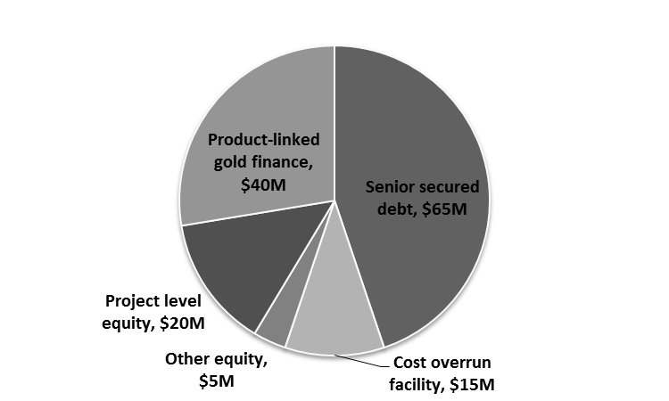
Tulu Kapi
Open Pit Financials
Project Financials @ US$1,250/oz
All-in Sustaining Costs | US$745/oz
All-in Costs (incl initial capex) | US$852/oz
Average annual EBITDA | US$51M
Net Cash after Debt Repayment (LOM) | US$278M
Net Cash after Debt Repayment in Y1-3 | US$135M
Geared after-tax NPV (8%) | US$133M
Geared IRR | 52%
Payback | 3-4 years
  Targeted Sources of US$145M Development Funding Required
    KEFI owns 95% of KEFI Minerals Ethiopia. Government 5% to increase to c. 25% with planned equity investment in KME
    Funding package close to being finalised with each syndicate member

Slide 11
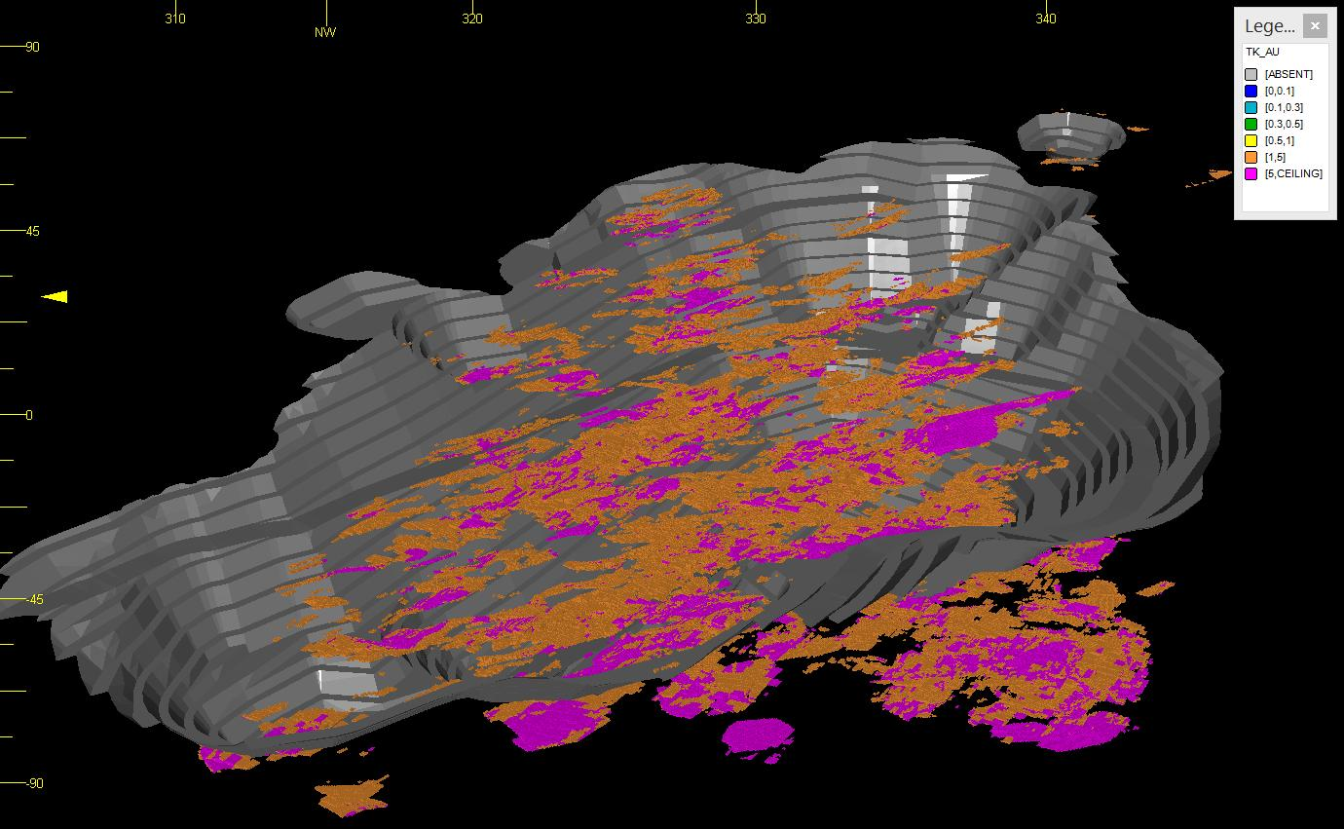
High-Grade Gold Below Tulu Kapi Open Pit
For Future Underground Development
SW
NE
Open pit contains
Ore Reserve
15.4Mt @2.12g/t Au,
containing 1.05Moz
Mineable resource outside open pit
1.3Mt @ 5.2g/t Au
containing 220Koz
Gold mineralisation open at depth, along strike and down plunge
Resource blocks below open pit:
>1.5g/t Au (brown) >5g/t Au (pink)

Slide 12
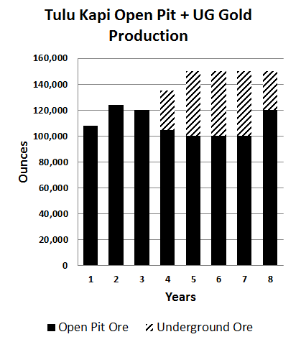
Tulu Kapi
Preliminary Economics of Underground Mine
  Thick, high-grade gold zones below open pit
  Underground mineable resource = 1.3Mt @ 5.2g/t
  Preliminary studies based on current resource only show:
    Open Pit + Underground production ≈ 150,000 ozs p.a.
    over 4 years
    Additional NPV (8%) ≈ US$44M (at $1,250/oz)
  Plus potential to triple current underground ounces
    Combined NPV (8%) of OP+UG gold production >US$200M
  Note: The above profile is indicative and based on preliminary studies only.

Slide 13
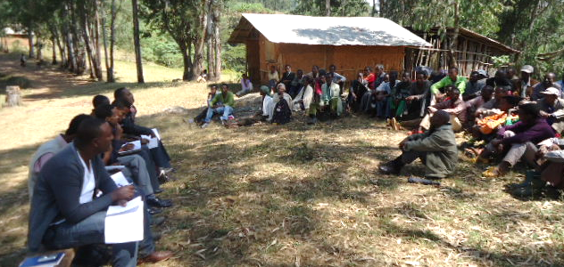
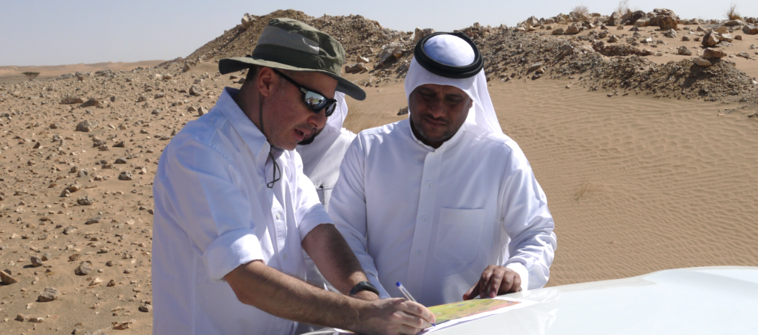
Key Milestones
  Tulu Kapi, Ethiopia
  2016:
  FEED stage of development - Completed
  PEA on underground mine - Completed
  Complete financing, start construction
  Start testing satellite gold deposits
  2017:
  Complete construction, commission production
  Jibal Qutman and Hawiah, Saudi Arabia
  2016:
  Jibal Qutman – submit Mining Licence Application
  Hawiah – start drilling to test large Cu-Au-Zn target
  2017:
  Trigger Jibal Qutman feasibility studies for development to follow start-up at Tulu Kapi

Slide 14

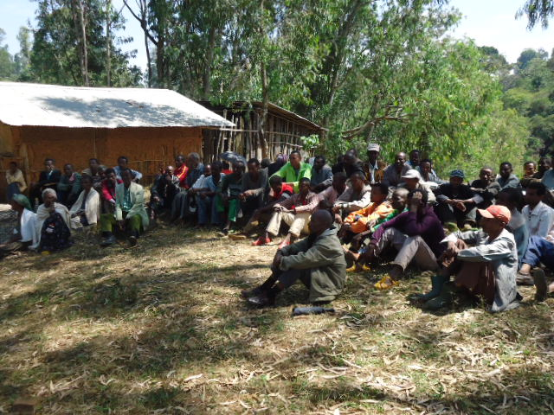

CONTACTS
Harry Anagnostaras-Adams, Executive Chairman
Mobile: +357 99457843
Jeff Rayner, Exploration Director
Wayne Nicoletto, Head of Operations
England - Registered office
Cyprus - Group corporate team
Ethiopia - Development and exploration teams
Saudi Arabia - Exploration team
Turkey - Support
Email: info@kefi-minerals.com
Website: www.kefi-minerals.com
Luther Pendragon Ltd ( Financial PR)
Harry Chathli, Claire Norbury, Ana Ribeiro
Tel: +44 (0) 20 7618 9100
  Local community briefing at Tulu Kapi
@kefiminerals
KEFI Minerals plc

